Slide 1
Medical Cost Prediction
Machine learning model and Streamlit app for estimating annual healthcare expenses

Slide 2
Introduction
Medical Insurance Cost Prediction System
Helps individuals estimate future healthcare expenses based on personal health and usage patterns. Unlike static estimates, this model adapts predictions based on multiple interacting risk factors.
This project uses a Gradient Boosting Regressor to generate accurate cost forecasts and a Streamlit UI for user interaction.
SU92-BSAIM-S25-030

Slide 3

01
Overview

Slide 4
Project summary and goal
This project develops a machine learning system to predict annual medical costs based on individual health, lifestyle, and healthcare usage data.
The model analyses multiple factors such as age, BMI, smoking habits, medical conditions, insurance details, and past healthcare expenses to generate cost estimates.
A Gradient Boosting Regressor is used to capture complex relationships between these variables and improve prediction accuracy.
The system is integrated into an interactive Streamlit web application that allows users to input their data and receive real-time predictions.
In addition to cost prediction, the system highlights key risk factors that may contribute to higher medical expenses.
Goal: To provide a simple, data-driven tool for understanding and estimating healthcare expenses.

Slide 5

Key inputs and outputs
Inputs: age, BMI, smoking, diabetes, hypertension, heart disease, insurance type, coverage %, admissions, doctor visits, medications, previous year cost.
Previous year cost acts as a strong baseline indicator of future expenses.
Outputs: estimated annual and monthly costs plus flagged risk factors.

Slide 6
Target audience & impact
Students
Researchers,
Healthcare Analysts (prototype level)

Slide 7

02
Data & Preprocessing

Slide 8
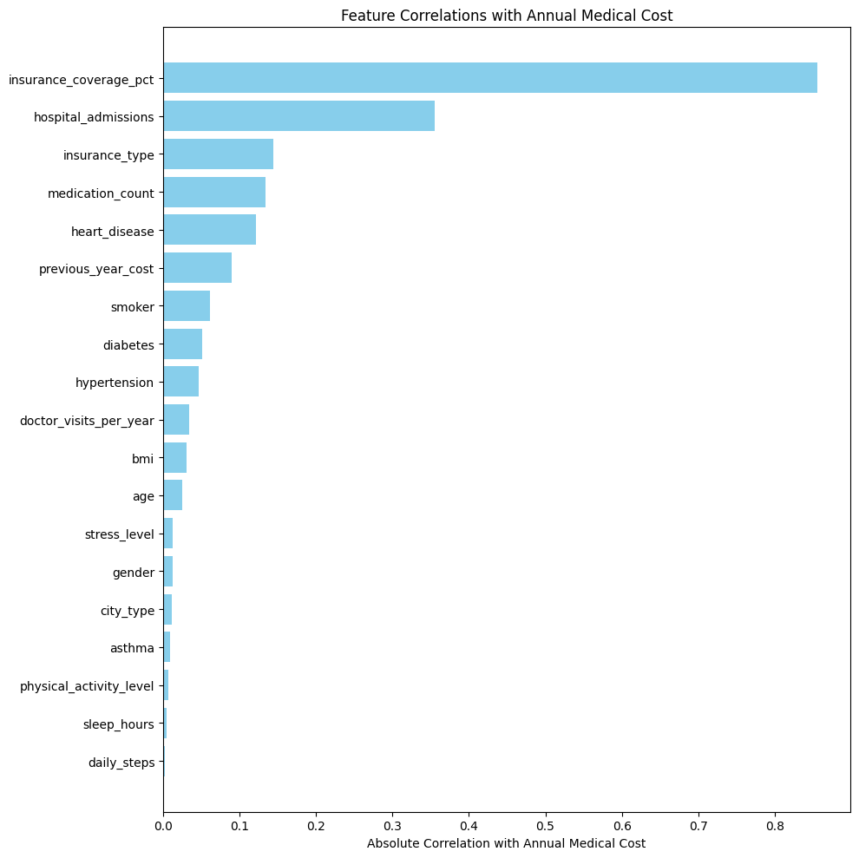
Dataset type and features
Dataset Size: (5000,20)
Dataset Nature: Publicly available synthetic data on Kaggle.
Uses structured tabular data (synthetic) containing demographic, clinical, utilization, insurance, and historical cost features.

Slide 9
Encoding & cleaning steps
Label encoding used for categorical features (smoker, insurance type)
Feature selection via correlation analysis and importance from preliminary models.
No scaling required due to tree-based model

Slide 10
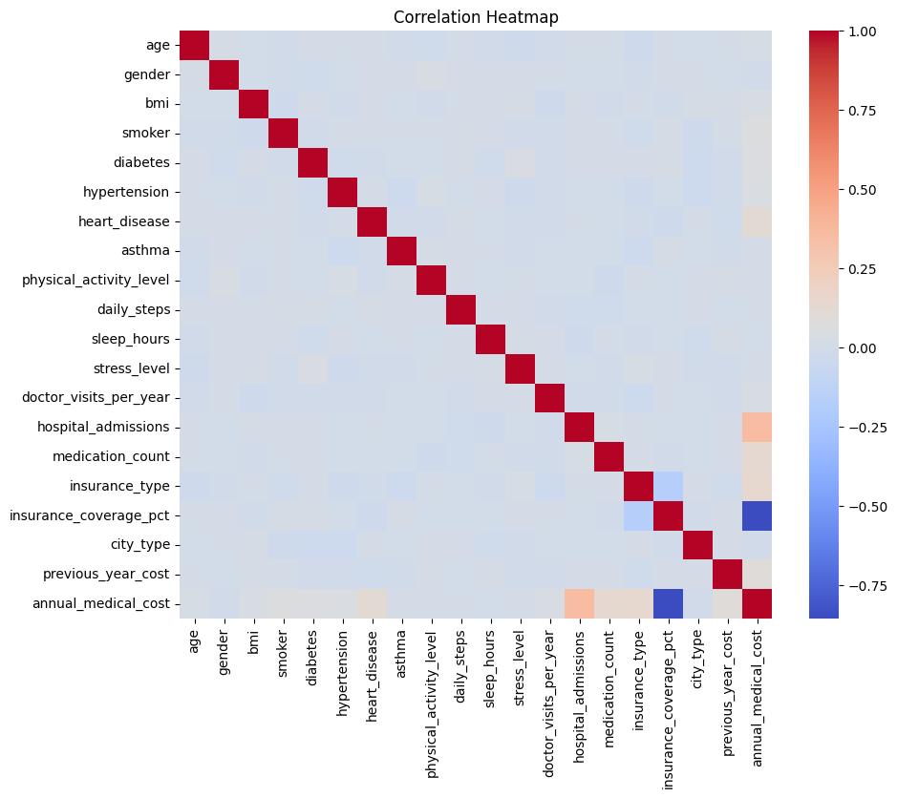
Feature selection strategy
Select features using correlation analysis and model-based importance.
Retain variables that improve validation metrics and interpretability; drop redundant or low-importance features.

Slide 11

02
Modeling & Results

Slide 12

Gradient Boosting Regressor choice
Gradient Boosting Regressor chosen based on strong performance in similar regression tasks.
Model tuning via cross-validation and hyperparameter search (learning rate, estimators, depth).

Slide 13
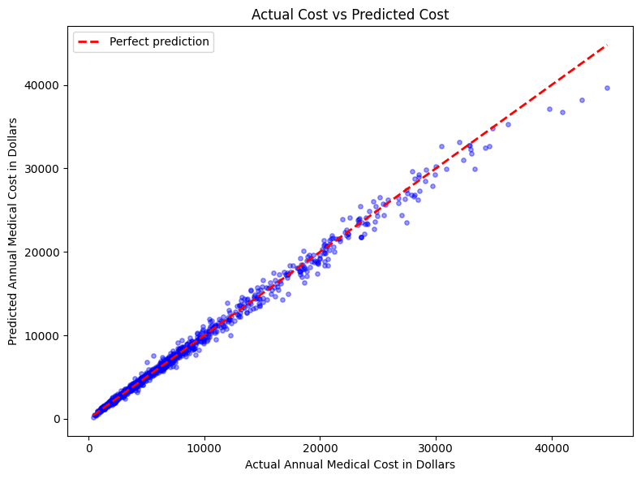
Performance: R² = 99.25%
80% Data for Training while 20% reserved for testing purpose.
Model achieves R² = 99.25%, indicating excellent fit on validation/test data.
The Root Mean Squared Error is about 623$ which is decent considering the cost ranging from 2000$ to 60000$.

Slide 14
Interpretation
Feature importance inferred from model (tree-based importance)
Features with highest correlation with the target feature (Annual Cost) are considered as important
Model is trained on a collection of 12 Features in the correlation graph in ascending order
20% dataset is reserved for testing Purposes.
Mean Absolute Error of 373$ indicate that the model can be used for general price predictions as medical costs range from 200$ to about 60000$ compared to which , it seems reasonable.
RMSE is 673$ because it penalizes large errors in cost data more (it overexposes the Outliers)
Model isn’t perfect as it still needs to be tested on real-world unseen data.

Slide 15

03
User Interface

Slide 16
Streamlit app: UI and flow
Model loaded using pickle file in Streamlit backend
Real-time prediction using user input form
Streamlit UI collects inputs, sends features to model, and returns annual estimates.
Design: clean form layout, result panel, and downloadable report.

Slide 17
Risk Detection
Risk Factors
System flags high-risk factors (smoking, high BMI, comorbidities) and highlights their contribution to cost.
Feedback & Disclaimer
Provide actionable feedback and disclaimers; option to export recommendations.

Slide 18

Limitations and improvements
Limitations:
Possible overfitting due to high model accuracy.
Feature dependency (e.g., previous cost leakage)
It heavily Depends on input quality.
Potential bias as its trained on synthetic data.
Its not a substitute for clinical advice.
Future: Incorporate real-world EHR data, more health metrics, fairness audits, and scalable deployment.

Slide 19
Conclusion
Remarks:
The project delivers a cost-prediction model which is high-performing model on available dataset.
Data Pipeline:
Data Input → Preprocessing → Model → Prediction → UI Output

Slide 20
THANKS
Feel Free to ask any questions !
su92-bsaim-s25-030@superior.edu.pk
BSAI-3A
Yours Sincerely,
Muhammad Qasim Ashfaq

